Slide 1
MedSync – A Centralized Resource Scheduling Platform
Final Project – SWENG 837: Software Design
Eli Vazquez
4/29/2025
Notes:
Hi, my name is Eli Vazquez, and welcome to my presentation on MedSync, a centralized resource scheduling platform designed specifically for small and medium-sized clinics.
This project applies object-oriented design principles, microservices architecture, and several established design patterns to solve real-world workflow challenges in healthcare environments.

Slide 2
Problem Statement
Small and medium-sized clinics often rely on manual or disconnected scheduling methods, such as sticky notes, verbal handoffs, or siloed calendars.
Double bookings and underutilized resources frequently occur due to lack of coordination.
Delays in patient care and staff frustration stem from inefficient communication between nurses, doctors, and admins.
There’s no unified view of resource availability, leading to ineffective event coordination.
A centralized, secure, and role-aware system is needed to streamline scheduling and improve clinical operations.
Notes:
Clinics often suffer from fragmented communication when scheduling resources like exam rooms, equipment, or provider time slots.
Most rely on hallway conversations or paper notes, which lead to double-bookings, underutilized assets, and workflow delays.
The problem is clear: there’s no centralized, role-aware, conflict-free system for coordinating these shared resources.

Slide 3
Solution Overview
Centralized Scheduling Platform
Role-Based Access Control (RBAC)
Real-Time Conflict Detection & Notifications
Calendar Synchronization
Microservices Architecture
Audit Logging & Compliance
Notes:
MedSync solves this by offering a centralized scheduling platform with features like role-based access, real-time conflict detection, calendar sync, and system notifications.
Admins, nurses, and doctors each have tailored dashboards.
Notifications alert users to changes or conflicts.
Integration with external calendars ensures real-time coordination beyond the clinic.

Slide 4
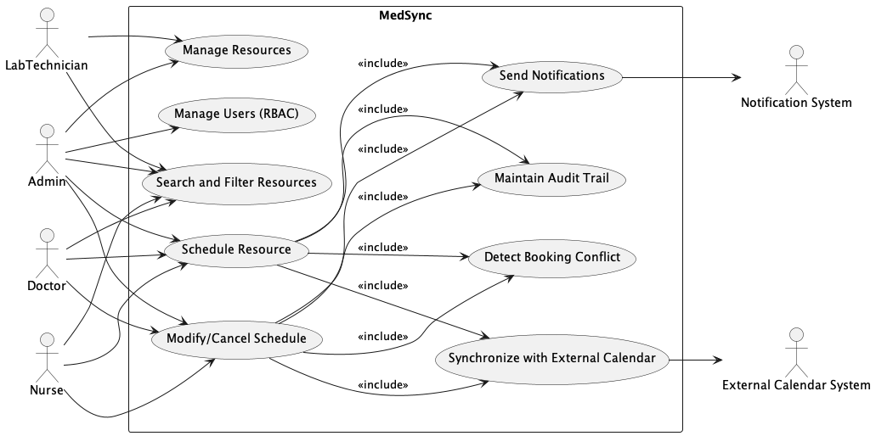
Use Case
Notes:
This diagram represents the primary use cases supported by MedSync and how various users interact with the system.
On the left, we see the primary actors — Admin, Nurse, Doctor, and Lab Technician — each with role-specific interactions. For example, all roles can schedule or modify bookings, while only Admins and Lab Technicians can manage resources.
The central use cases, like Schedule Resource, Modify/Cancel Schedule, and Manage Users, are supported by several system-level functionalities such as conflict detection, notification dispatch, and audit logging — modeled here as included use cases.
On the right, we have supporting systems — the Notification System and External Calendar System — which are integrated via included behaviors like syncing and alerts.

Slide 5
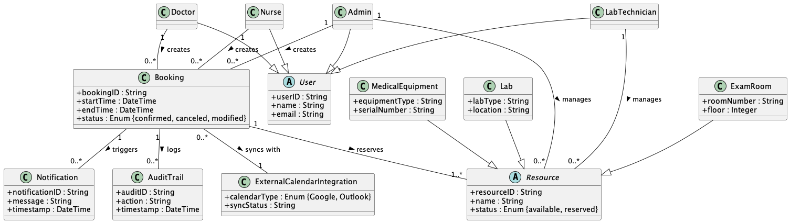
Domain Model
Notes:
The Domain Model defines the core concepts in the MedSync system and their relationships, independent of implementation.
At the center is the Booking class, which links users to resources and tracks details like time, status, and audit information.
We designed a User hierarchy with roles like Admin, Nurse, Doctor, and Lab Technician extending a base User class. This structure enables role-specific behavior while maintaining shared attributes.
Similarly, we abstracted the concept of a Resource into a parent class, extended by ExamRoom, MedicalEquipment, and Lab, allowing the system to handle all types of schedulable resources in a flexible way.
We also included entities like Notification, AuditTrail, and ExternalCalendarIntegration, which are critical for non-functional requirements like traceability, alerts, and interoperability.
This model served as the foundation for both our class diagram and our microservice boundaries.

Slide 6
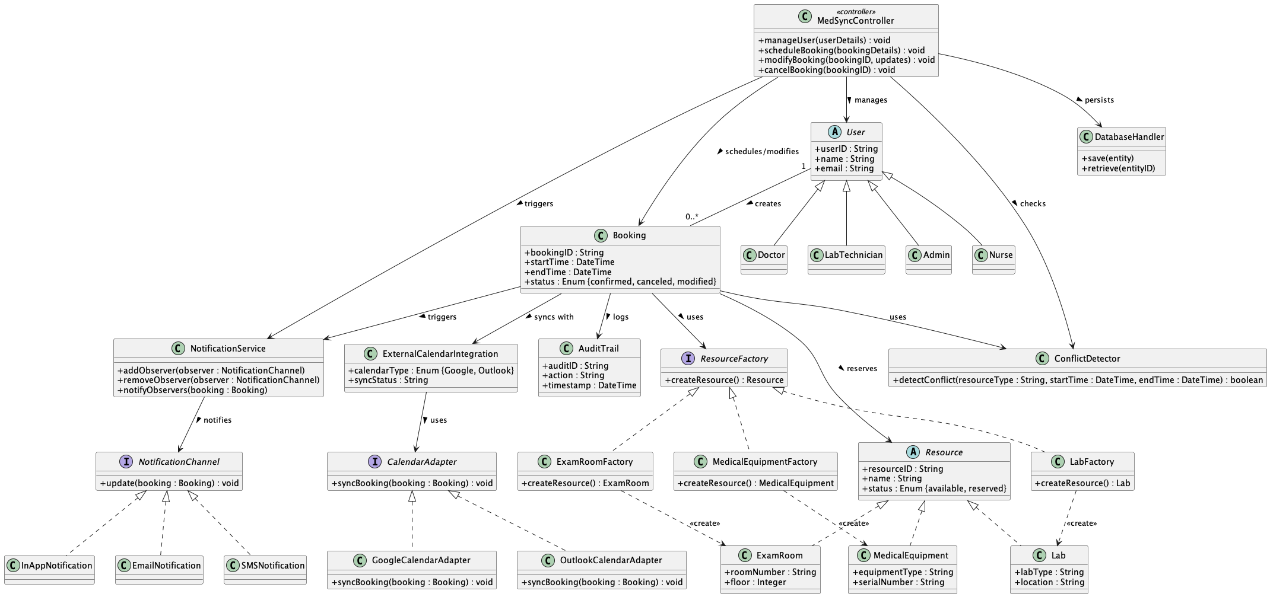
Class Diagram
Notes:
This class diagram builds on our domain model by refining associations and integrating key design patterns.
The central class is Booking, which captures scheduling information and connects with multiple services.
On the left, we implement the Observer pattern for notifications. The NotificationService notifies multiple NotificationChannel implementations like EmailNotification, SMSNotification, and InAppNotification when a booking is created or modified.
On the right, we use the Abstract Factory pattern to create Resource objects such as ExamRoom, MedicalEquipment, and Lab through their respective factories. This allows for consistent and scalable resource instantiation.
We’ve also added an Adapter pattern for calendar integration — supporting systems like Google and Outlook through interchangeable adapters.
The MedSyncController orchestrates user interactions and relies on services like the DatabaseHandler and ConflictDetector, promoting separation of concerns and testability.
Together, these classes reflect a clean architecture that enforces modularity, extensibility, and real-world flexibility.

Slide 7
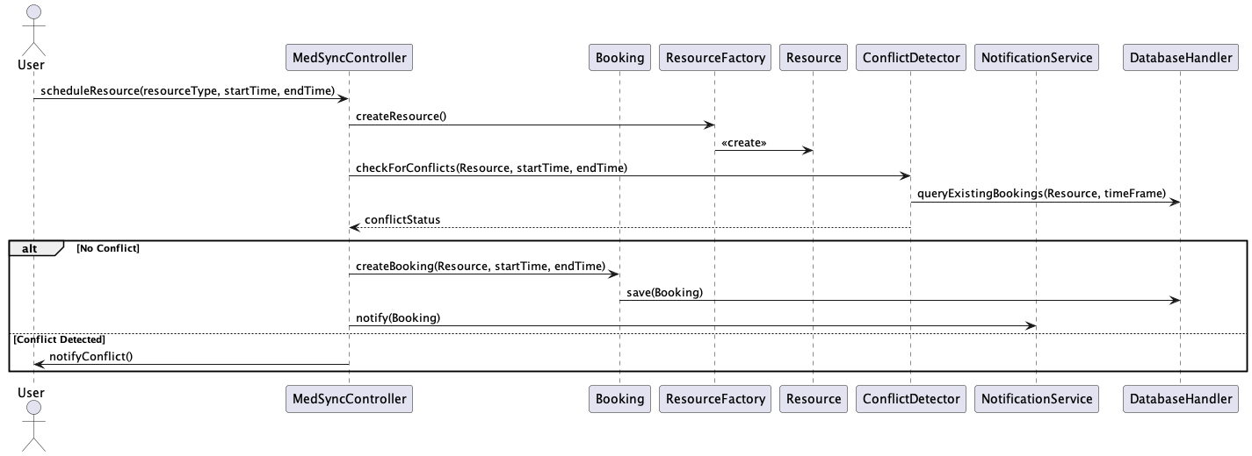
Sequence Diagram: Schedule resource
Notes:
This sequence diagram illustrates the Schedule Resource use case.
The flow begins when a user, such as a Nurse or Doctor, invokes the scheduleBooking() method through the MedSyncController.
Before creating the booking, the system validates conflicts using the ConflictDetector, helping prevent overlapping reservations.
If no conflicts are found, the Booking object is created and associated resources are reserved.
Afterward, the booking triggers three parallel system operations:
• It logs the action via the AuditTrail,
• It notifies observers (email, in-app, etc.) via the NotificationService,
• And it synchronizes with external calendars using the CalendarAdapter.
This sequence encapsulates core responsibilities, real-time updates, and cross-system integrations, showing the system’s responsiveness and maintainability.

Slide 8
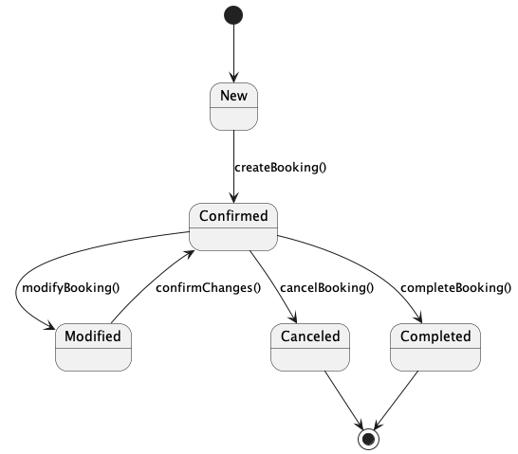
State Diagram: Booking
Notes:
This state diagram models the lifecycle of a Booking within the MedSync system.
A booking begins in the New state, triggered by a user action like scheduling through the createBooking() method
Once the booking is confirmed, it enters the Confirmed state.
From here, three transitions are possible:
• Modified: If the user updates the schedule, the system temporarily transitions to Modified, allowing changes to be reviewed and re-confirmed.
• Canceled: If the user cancels the booking, it transitions to the Canceled state, which is terminal.
• Completed: Once the appointment or resource usage concludes, the booking transitions to Completed.
Each terminal state (Canceled or Completed) exits the workflow using a UML exit point.
This diagram emphasizes how MedSync captures the full lifecycle of resource reservations, ensuring traceability and proper state transitions for all bookings.

Slide 9
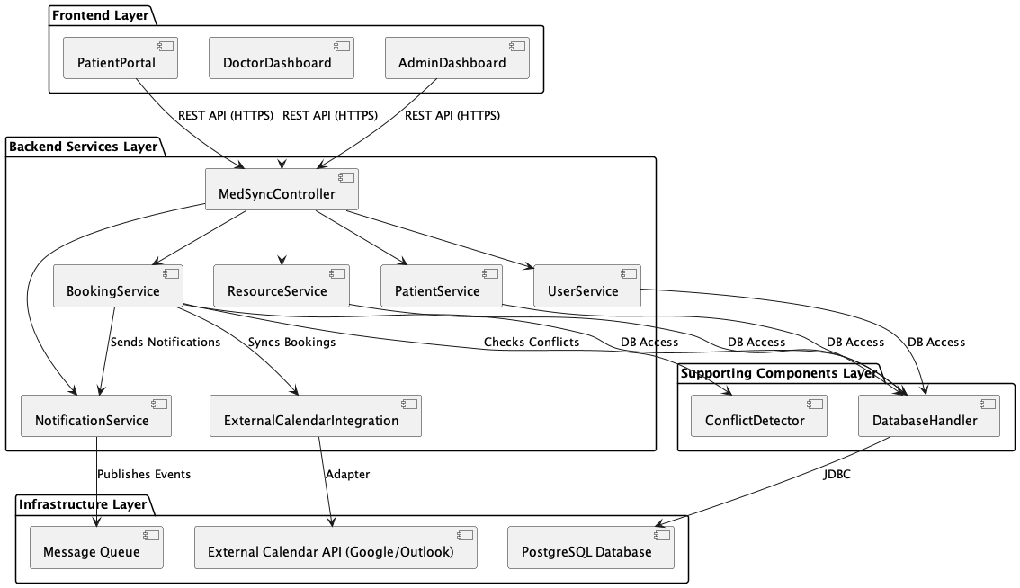
Component Diagram
Notes:
This component diagram presents a high-level architectural view of the MedSync system, highlighting its modular design through layered components.
At the Frontend Layer, we have three user-facing interfaces: the Patient Portal, Doctor Dashboard, and Admin Dashboard. These interact with the backend using secure REST APIs.
The Backend Services Layer is coordinated by the MedSyncController, which delegates to four microservices: BookingService, ResourceService, PatientService, and UserService.
Supporting services like the NotificationService and ExternalCalendarIntegration enable asynchronous communication and third-party calendar synchronization.
We’ve also included a Supporting Components Layer, which handles technical concerns like conflict detection and database operations via the ConflictDetector and DatabaseHandler components.
Finally, the Infrastructure Layer includes core dependencies such as the PostgreSQL database, a message queue for event publishing, and external calendar APIs like Google or Outlook. These are accessed using adapters or JDBC.
This separation of concerns improves maintainability, scalability, and fault tolerance—key goals of the MedSync architecture.

Slide 10
Architectural Pattern – Microservices
Decentralized Services: Booking, Resource, and User services operate independently.
Loose Coupling: Services communicate via REST APIs and a message queue.
Scalability: Components can scale based on demand.
Resilience: Faults are isolated within service boundaries.
Tech Agnosticism: Services can evolve with different tech stacks if needed.
Database per Service: Ensures autonomy and reduces contention.
Aligned with Domain Boundaries: Mirrors real-world clinic roles and responsibilities.
Notes:
MedSync is built on a microservices architecture, allowing us to divide functionality into modular services—like Booking, Resource, User, and Patient—each encapsulating its own logic and data.
Services are loosely coupled and communicate through well-defined REST APIs or message queues, which gives us great flexibility. For instance, if we needed to scale the BookingService to handle higher traffic, we could do that without touching other components.
Each service has its own database, allowing for true independence and minimizing the risk of a single point of failure. This setup aligns well with real-world clinic operations and roles.
Overall, the microservices architecture supports our goals of scalability, maintainability, and agility in deploying new features or handling failures.

Slide 11
Design Principles & Patterns
GRASP:
Controller: MedSyncController manages high-level coordination.
Creator: Booking creates AuditTrail and triggers NotificationService.
Information Expert: Each service handles its own domain logic.
SOLID:
Single Responsibility: Services like UserService and BookingService have focused concerns.
Open/Closed: New resource types can be added via factories without modifying core logic.
Dependency Inversion: Services depend on interfaces like CalendarAdapter.
GoF Patterns:
Observer: NotificationService broadcasts updates to channels like SMS, Email, In-App.
Abstract Factory: ResourceFactory pattern used for creating ExamRoom, Lab, etc.
Adapter: Integrates with external calendars (Google, Outlook) via CalendarAdapter.
Notes:
Throughout the MedSync architecture, we applied a range of design principles and patterns.
From the GRASP principles, MedSyncController acts as our Controller, orchestrating use case logic. The Creator and Information Expert principles help keep our logic distributed appropriately.
We also embraced SOLID principles. Each service follows a single responsibility, and we designed with extension in mind—like allowing new resources via the factory pattern without altering existing code.
On the pattern side, we applied the Observer pattern to enable flexible notifications, an Abstract Factory for scalable resource creation, and an Adapter pattern to connect with external calendar systems.

Slide 12
Conclusion
Designed MedSync to address resource scheduling fragmentation in clinics.
Applied OOAD principles for maintainable, scalable structure.
Leveraged GRASP, SOLID, and GoF patterns for clear responsibility and modularity.
Adopted Microservices architecture with independent services and DBs.
Ensured real-time sync, RBAC security, and calendar integrations.
Developed full UML suite: Use Case, Class, Sequence, State, Activity, Component, Deployment.
Notes:
To wrap things up, MedSync was designed to solve real coordination challenges in small and mid-sized clinics.
We used Object-Oriented Analysis and Design principles to keep the system modular and scalable, and reinforced that with solid architectural patterns like GRASP, SOLID, and GoF.
By using a microservices approach, each concern—whether it’s booking, notifications, or user management—was encapsulated and scalable on its own.
And to communicate this architecture clearly, we created a comprehensive UML suite, from use case and class diagrams to deployment and component views.
This course has significantly strengthened my software design skillset. I now feel confident applying OOAD principles and using UML to clearly communicate system architecture.
I learned how to use design patterns effectively—not just academically, but in a practical, problem-solving context. The emphasis on modularity, scalability, and clear responsibility helped me better understand how to architect systems that are easy to evolve.
And most importantly, I’m walking away from this project with a better grasp of how to balance technical detail with clear communication—an essential skill for any software architect or team leader.

